Slide 1









01204453 Web Information Retrieval and Mining
Department of Computer Engineering Faculty of Engineering, Kasetsart University Bangkok, Thailand.

Slide 2

Outline
Introduction
Brief History
The IR Problem
The IR System
Web Search

Slide 3

Motivation
Information Retrieval (IR)
How to store
How to extract/represent
How to query
How to access/search
How to present
Serve the users’ (complex) information need
Why Information Retrieval (not Data Retrieval)?

Slide 4

Terminology
Data Retrieval
Documents containing the keywords in the user query
Language with clearly defined conditions
Single error means total failure
Deal with a well defined structure and semantics data
Knowledge Discovery
Information Retrieval
Documents concerned more information about a subject
Query translated from the user information need
Inaccurate and small errors are likely to go unnoticed
Deal with natural language and semantically ambiguous text

Slide 5

Information Retrieval
Early goals of the IR area
Indexing text and searching for useful documents in a collection
Nowadays, research in IR
Modeling
Web search
Text classification
System architecture
User interfaces
Data visualization
Filtering
Languages
– ...

Slide 6





Slide 7

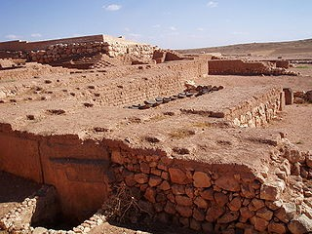
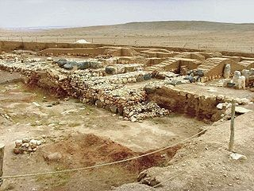
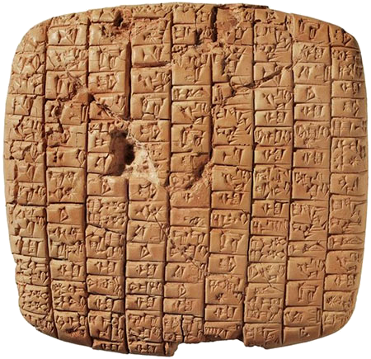
Early Developments
For more than 5000 years, man has organized information for later retrieval and searching
This has been done by compiling, storing, organizing, and indexing
For holding the various items, special purpose buildings, called libraries, are used
The oldest known library was created in Ebla, in the Fertile Crescent, between 3000 and 2500 BC

Slide 8
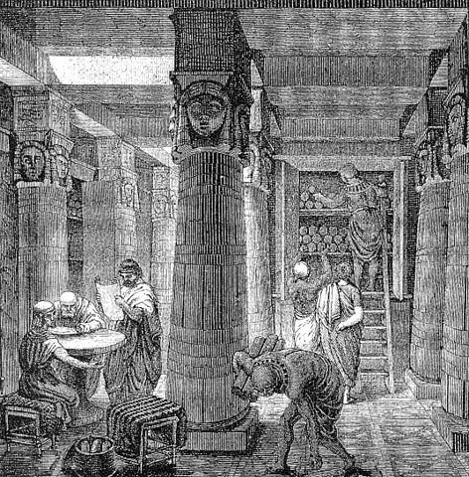
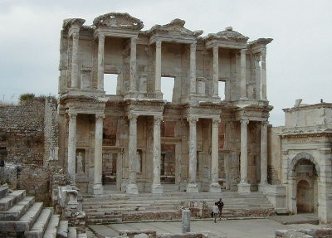
Early Developments
By 700 BC, Assyrian king Ashurbanipal created the library of Nineveh, on the Tigris river
Contained more than 30,000 clay tablets
By 300 BC, Ptolemy Soter, a Macedonian, created the Great Library in Alexandria
Nowadays, libraries are everywhere

Slide 9
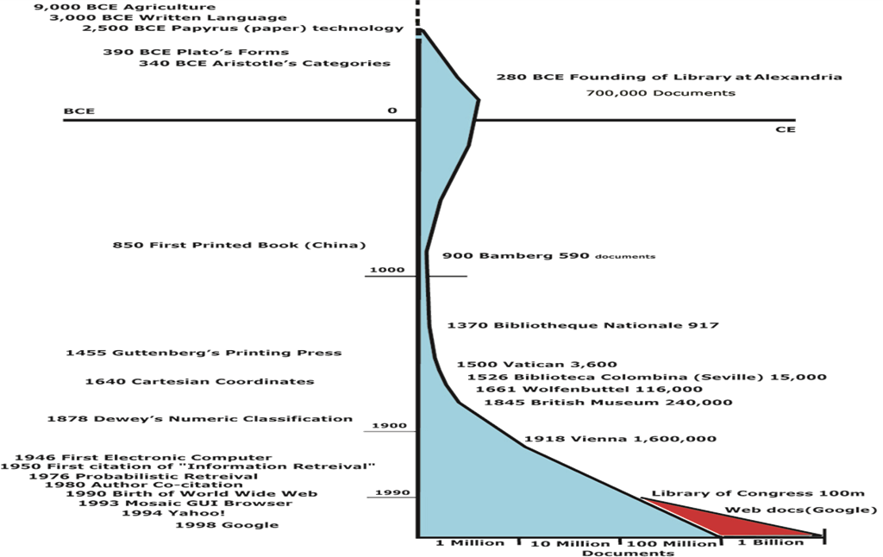

Slide 10
Early Developments
Since the volume of information in libraries is always growing, it is necessary to build specialized data structures for fast search—the indexes
For centuries indexes have been created manually as sets of categories, with labels associated with each category
The advent of modern computers has allowed the construction of large indexes automatically
10

Slide 11

Early Developments in IR
During the 50’s, research efforts in IR were initiated by pioneers such as Hans Peter Luhn, Eugene Garfield, Philip Bagley, and Calvin Moores, who allegedly coined the term Information Retrieval
In 1962, Cyril Cleverdon published the Cranfield studies on retrieval evaluation
In 1963, Joseph Becker and Robert Hayes published the first book on IR
In the late 60’s, key research conducted by Karen Sparck Jones and Gerard Salton, among others, led to the definition of the TF-IDF term weighting scheme

Slide 12
Early Developments in IR
In 1978, the first ACM SIGIR International Conference on Information Retrieval was held in Rochester
In 1979, van Rijsbergen published a classic book entitled Information Retrieval, which focused on the Probabilistic Model
In 1983, Salton and McGill published a classic book entitled Introduction to Modern Information Retrieval, which focused on the Vector Model

Slide 13

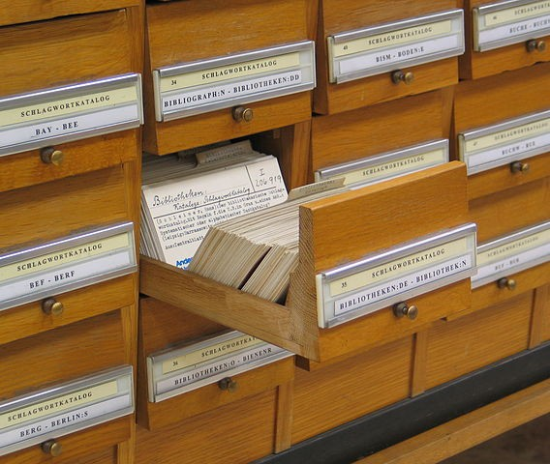
Libraries and Digital Libraries
Libraries were among the first institutions to adopt IR systems for retrieving information
Initially, such systems consisted of an automation of existing processes such as card catalogs searching
– Restricted to author names, titles

Slide 14
Libraries and Digital Libraries
In the next generation, Increased search functionality was added
– E.g., subject headings, keywords, query operations
Nowadays, the focus has been on improved graphical interfaces, electronic forms, hypertext features

Slide 15

IR at the Center of the Stage
Previously, IR was an area of interest restricted mainly to librarians and information experts
A single fact changed these perceptions—the introduction of the Web, which has become the largest repository of knowledge in human history
The Web also introduced difficult task on finding useful information
Searching on the Web is all about IR and its technologies
Thus, almost overnight, IR has gained a place with other technologies at the center of the stage

Slide 16




Slide 17

The IR Problem
Users of modern IR systems have information needs of varying complexity
An example of the simple information need:
Look for the link to the homepage of a company or institution
An example of the complex information need:
Find all documents that address the role of the Federal Government in financing the operation of the National Railroad Transportation Corporation

Slide 18
The IR Problem
This full description of the user need is normally not good for querying the IR system
Instead, the user would first translate into a query
– A set of keywords summarized his/her information need
Given the user query, the key goal of the IR system is to retrieve the useful or relevant information

Slide 19
The IR Problem
Thus, the IR system must rank the information items according to a degree of relevance to the user query
The IR problem:
The key goal of an IR system is to retrieve all the items that are relevant to a user query, while retrieving as few non- relevant items as possible
The notion of relevance is of central importance in IR

Slide 20

Basic Concepts
The effective retrieval of relevant information is directly affected by 2 factors:
The user task
The logical view of the documents
20

Slide 21

















The User Task
The action when the user first creates a query and then submits to the system, called “searching” or “querying”
For a poorly defined or inherently broad query, the user need to perform “browsing” or “navigating” the retrieved documents
Searching
Document Collection
Browsing
Notes:
คนอาจจะหาแล้วได้ผลไม่ตรง เลยอาจกดหาใหม่ทั้งๆที่อาจเป็นที algor การหาก็ได้

Slide 22

Document
A single unit of information
Typically, text in a digital form
e.g., book, article, passage, e-mail, web page, etc.
Documents in a collection are frequently represented through a set of index terms or keywords (directly extracted or expertly generated) to provide a logical view
Notes:
Documetn จะแสดงผ่าน inder terms หรือ keywords เพื่อให้ a logical view

Slide 23
The Logical View of the Documents
The use of full text
⇒ Provide the most complete logical view
⇒ Take higher computational costs
The use of a small set of categories generated by human experts
⇒ Provide the most concise logical view
⇒ Might lead to retrieval of poor quality
Notes:
ในการเลือก Set ของ index term มีทั้งการ เลือกทั้งหมดเลย ข้อดีคือข้อมูลได้เยอะแนะ ข้อเสีย ช้าแน่นอน หรืออีกแบบนึงคือเลือกให้ logical view สั้นที่สุด ข้อดี ประมวลผลเร็วจัดเก็บไม่เยอะ ข้อเสีบข้อมูลอาจจะหายไปก็ได้นะ ดังนั้นต้องดูประสิทธิภาพของเราด้วยว่าควรเลือกแบบไหน

Slide 24























The Logical View of the Documents
Several intermediate logical views might be adopted an IR system
document
accents, spacing, etc.
text
stopword
noun groups
stemming
automatic or manual indexing
text + structure
structure recognition
structure
full text index terms
Text operations reduce the complexity of documents
Notes:
มี document มาถึงอย่างแรกก็คือการตัดมาเป็นคำๆ ถ้าเอาไปทำเป็น indexเลยจะได้ complete logical view แต่ถ้าเป็นเอกสาที่มีโครงสร้างเช่น HTML อยู่ควรจะต้องมีการตัดคำทิ้ง(stop word คำที่ไม่มีความสามรถในการแยกแยะเอกสารที่หนึ่งจากกลุ่มเอกสารได้เช่น is am are) Computer เป็น Stopword มั้ย ตอบ เป็นก็ได้หรือไม่เป็นก็ได้ เช่นในDomain Document ของ Computer ก็จะเป็น แต่ถ้าเป็น Document ทั่วๆไปก็ไม่เป็น noungroup คือสรุปแทนคำหรือกลุ่มคำเหล่านั้นได้ ก็จะสั้นลง Stemming คือการแทนคำเหล่านั้นด้วยรากศัพท์ของมัน แต่การทำ Stemmingดีจริงๆมั้ย บางที่ก็ดีบางทีก็ไม่ดีเช่น Market กับ Marketing มันคนละความหมายกัน แต่ข้อดีก็มีอยู่ ต้องไป Tradeoff

Slide 25




Slide 26























The Retrieval Process
User Interface
text
user need
text
Text Operations
logical view
logical view
Query
Indexing
Document
Manager
user feedback ^{Operations}
query
inverted file
Searching
Index
Document Collection
retrieved docs
ranked docs
Ranking
Notes:
ระบบภาพรวมของ information retrival

Slide 27




Slide 28

Web Search
Internet is the largest source containing several kinds of data.
Web search is one of the IR applications that concerns hypertext documents (web pages) in the Internet.
Dealing with the web search has still been very challenging for years.

Slide 29

Characteristics of the WWW
Very huge resource
Static and dynamic web pages
Not easy to measure the size of the WWW
Proliferation and dynamic nature
Decentralized content publishing
Different quality of content
Various natural languages
Wide variation of presentations
Colors, fonts, structures, etc.

Slide 30

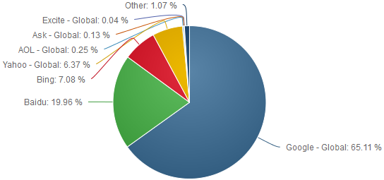
Search Engine Market Share
Total Market Share
Search Engine | Total Market Share
Google - Global | 65.11%
Baidu | 19.96%
Bing | 7.08%
Yahoo - Global | 6.37%
AOL - Global | 0.25%
Ask - Global | 0.13%
Excite - Global | 0.04%
August 2016 → http://marketshare.hitslink.com
30

Slide 31

Search Engine Trend
Year | Annual Number of Google Searches | Average Searches Per Day
2014 | 2,095,100,000,000 | 5,740,000,000
2013 | 2,161,530,000,000 | 5,922,000,000
2012 | 1,873,910,000,000 | 5,134,000,000
2011 | 1,722,071,000,000 | 4,717,000,000
2010 | 1,324,670,000,000 | 3,627,000,000
2009 | 953,700,000,000 | 2,610,000,000
2008 | 637,200,000,000 | 1,745,000,000
2007 | 438,000,000,000 | 1,200,000,000
2000 | 22,000,000,000 | 60,000,000
1998 | 3,600,000 *Googles official first year | 9,800
June 2015 → http://www.statisticbrain.com/google-searches/

Slide 32









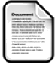








Web Search Engine Architecture
keyword
keyword
web collection
keyword
web crawlers
WWW
index
user interface
Notes:
Web crawler เอาข้อมูลไปเก็บใน Web collection แล้วนำไปสร้าง Logical view ของ web document แล้วนำไปทำดรรชนี (index) แล้วก็นำมาให้ user ใช้ในการ retrieval ข้อมูล

Slide 33









Course Organization (before Midterm)
User Interface
text
user need
text
Text Operations
logical view
logical view
Query
Indexing
Document
user feedback ^{Operations}
Manager
query
inverted file
web graph
Searching
Index
4-7
Document Collection
retrieved docs
Ranking
Web Modeling
Link Analysis
web pages
ranked docs
6
Internet
2-3
Notes:
ก่อนmidterm มีเท่านี้ เขียวๆ

Slide 34




Course Organization (after Midterm)
User Interface
text
user need
12
text
Text Operations
logical view
logical view
Query
Indexing
Document
user feedback ^{Operations}
Manager
query
inverted file
web graph
Searching
Index
Document Collection
retrieved docs
14
Ranking
Web Modeling
Link Analysis
web pages
ranked docs
9
Spam
Internet
13
Detection
10-11

Slide 35


